Slide 1


Reddit Lite
Joseph Pereniguez 18129119 - leader
Alexandre Thauvin 18129014

Slide 2
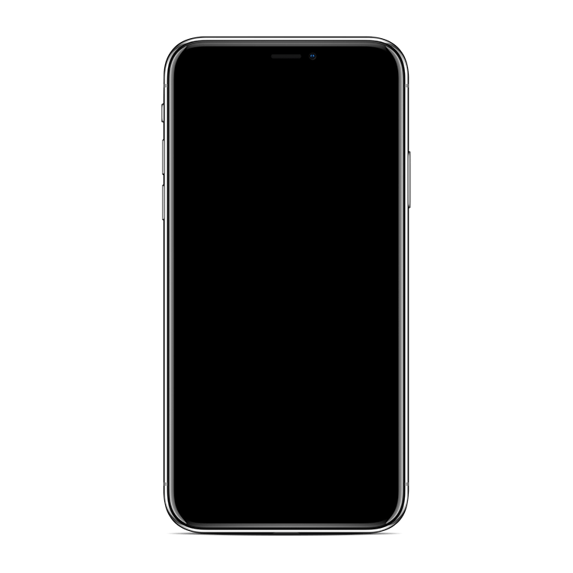
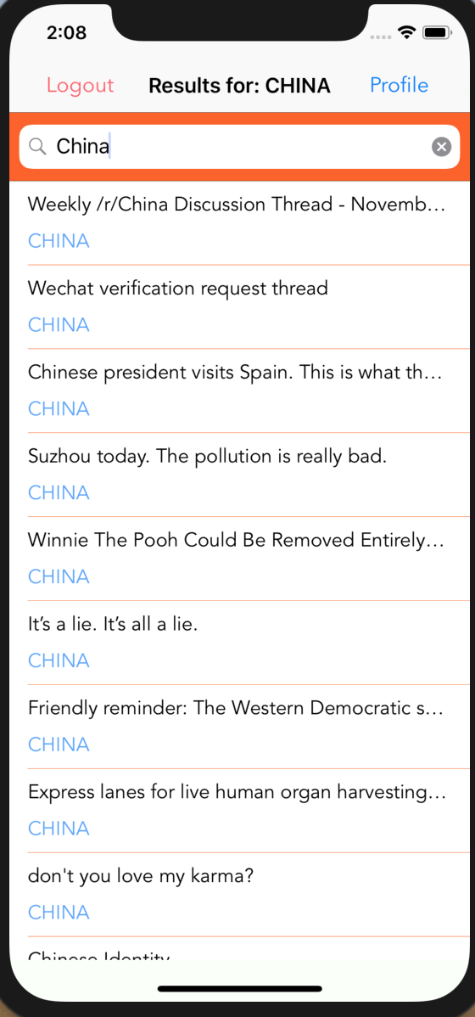
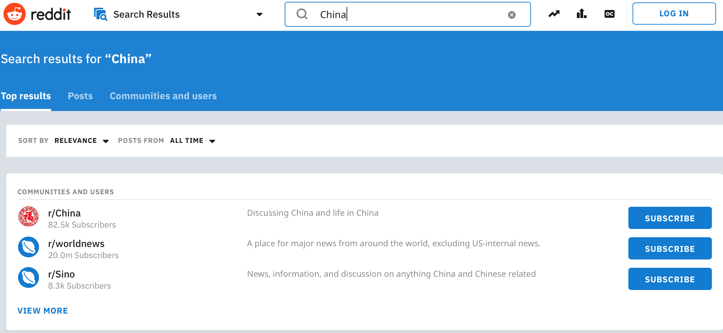
Reddit Lite
- Uninteresting content
- Unwanted content
- Too much information
- The user choose the topic
- Only wanted content
- Only wanted information

Slide 3


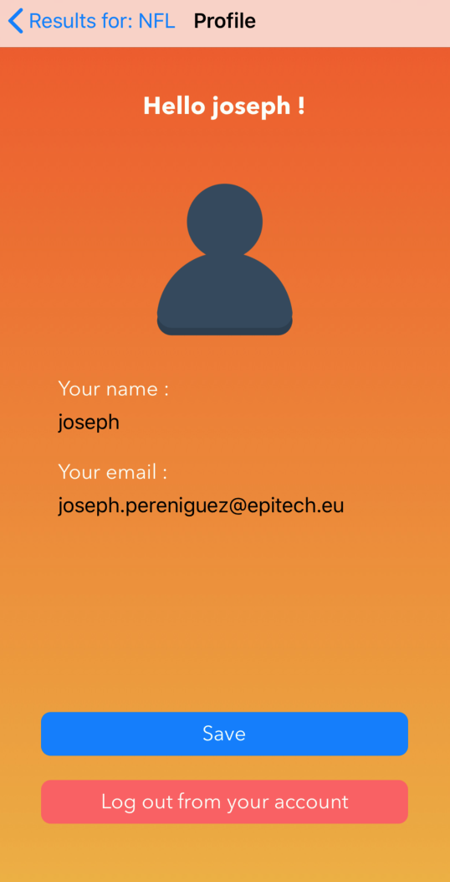
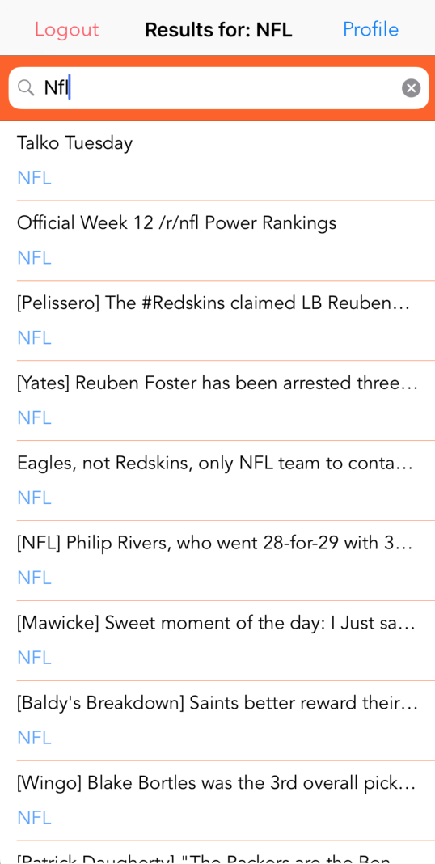
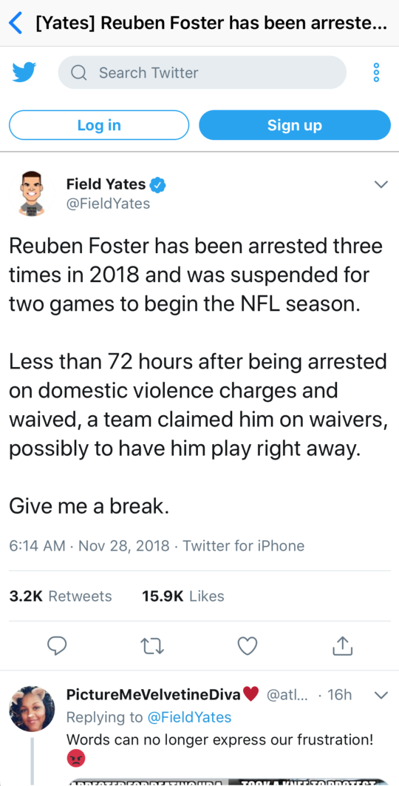
Reddit Lite
Or signup if the user has not register yet
Access to the user account and update the informations
Search articles by topic that interests the user
Read articles that interests the user
Sign Into the app

Slide 4
Reddit Lite
DEMO

Slide 5
Reddit Lite
MainViewController: UIViewController
UIButton
LoginViewController: UIViewController
UITextField
UIButton
SignupViewController: UIViewController
UITextField
UIButton
RedditViewController: UIViewController
UISearchBar
UITableView
UIButton
ProfileViewController: UIViewController, UIImagePickerControllerDelegate, UINavigationControllerDelegate
UILabel
UIButton
UIImage
PostCell: UITableViewCell
UILabel
WebVC: UIViewController
WKWebView

Slide 6
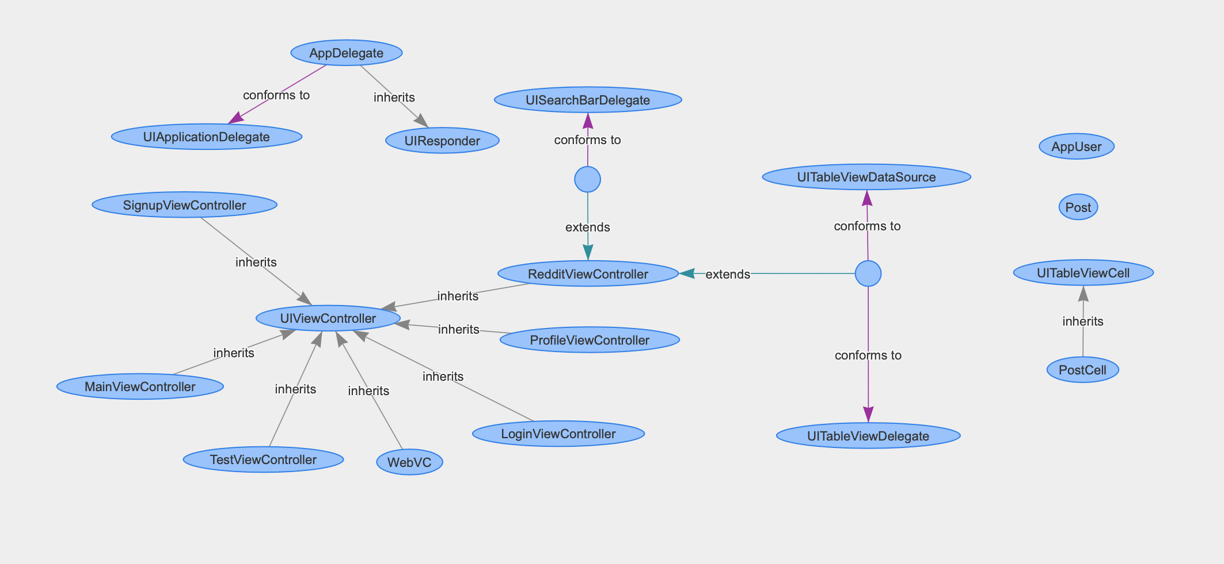
Reddit Lite

Slide 7
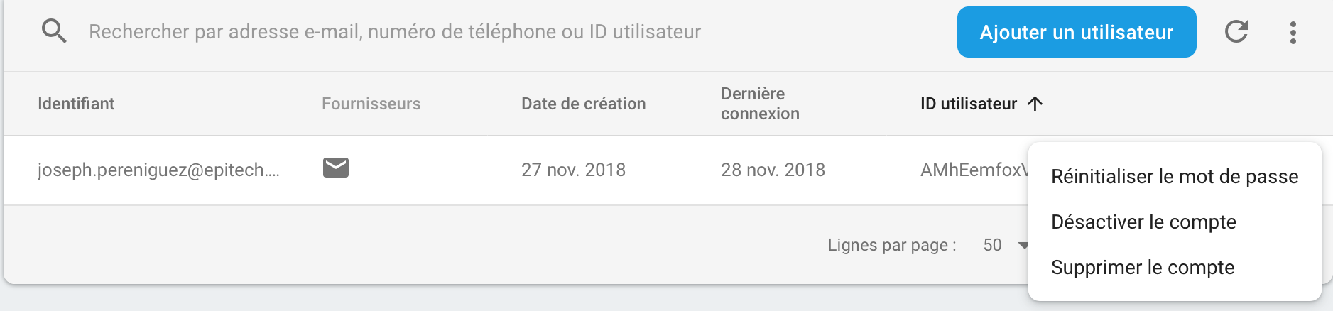
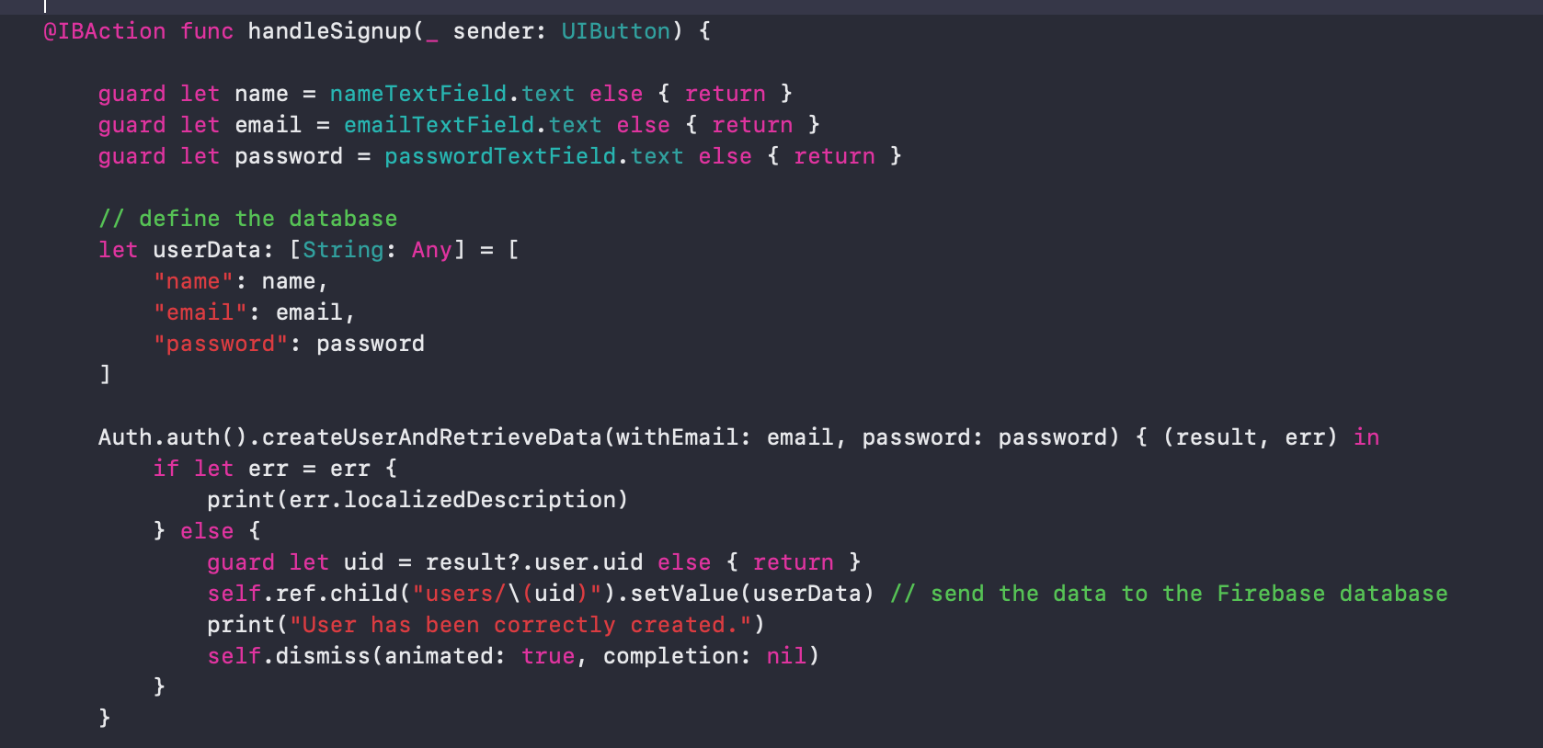
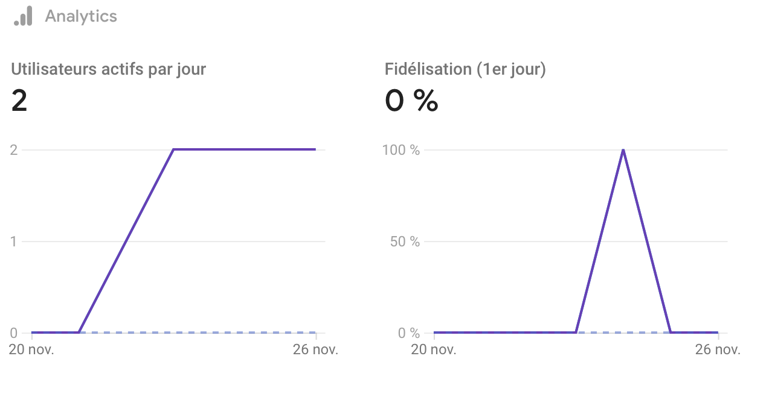
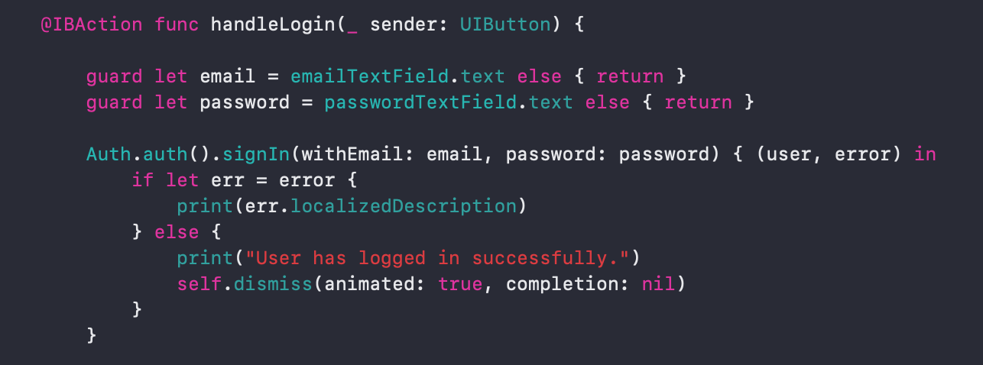
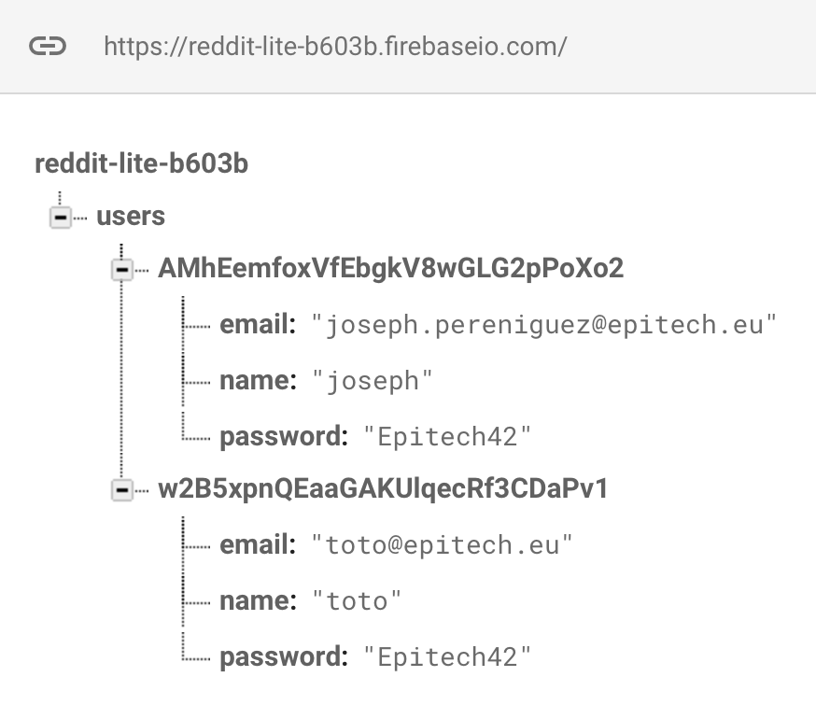

Reddit Lite
Sign In & Sign up
Alexandre Thauvin 18129014

Slide 8
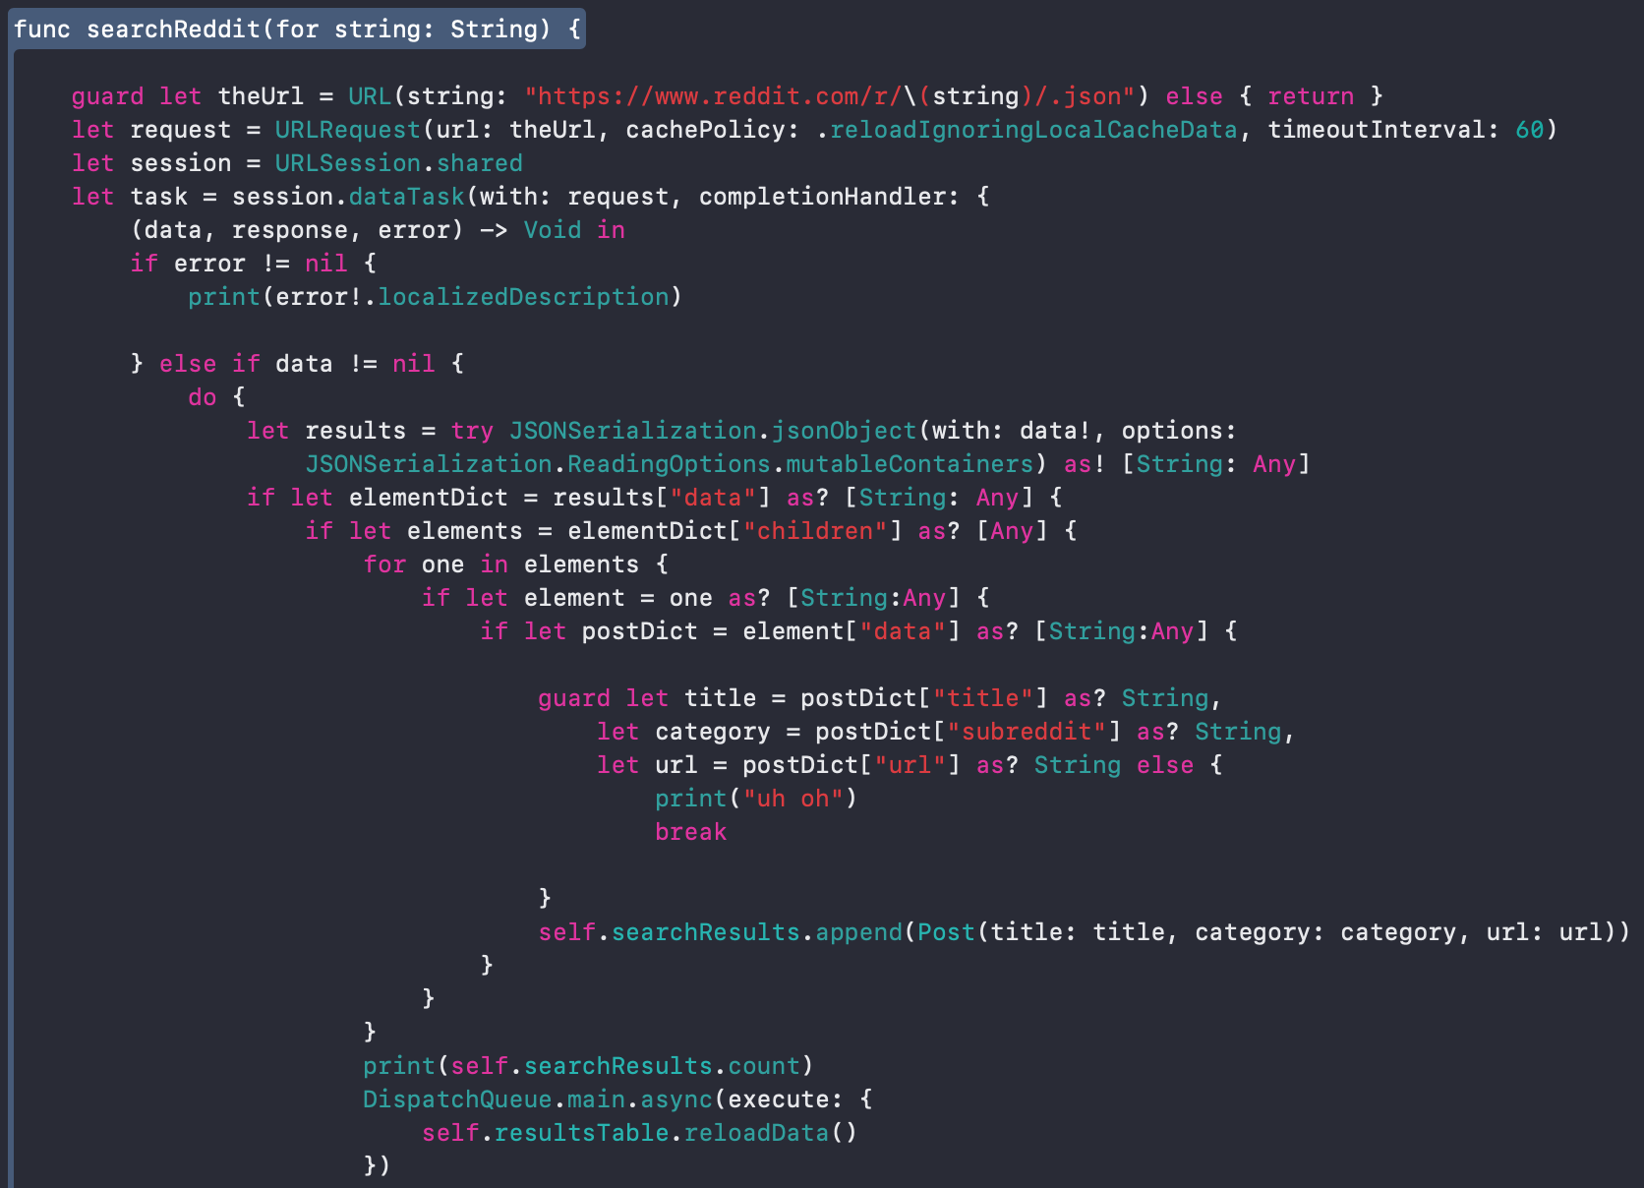
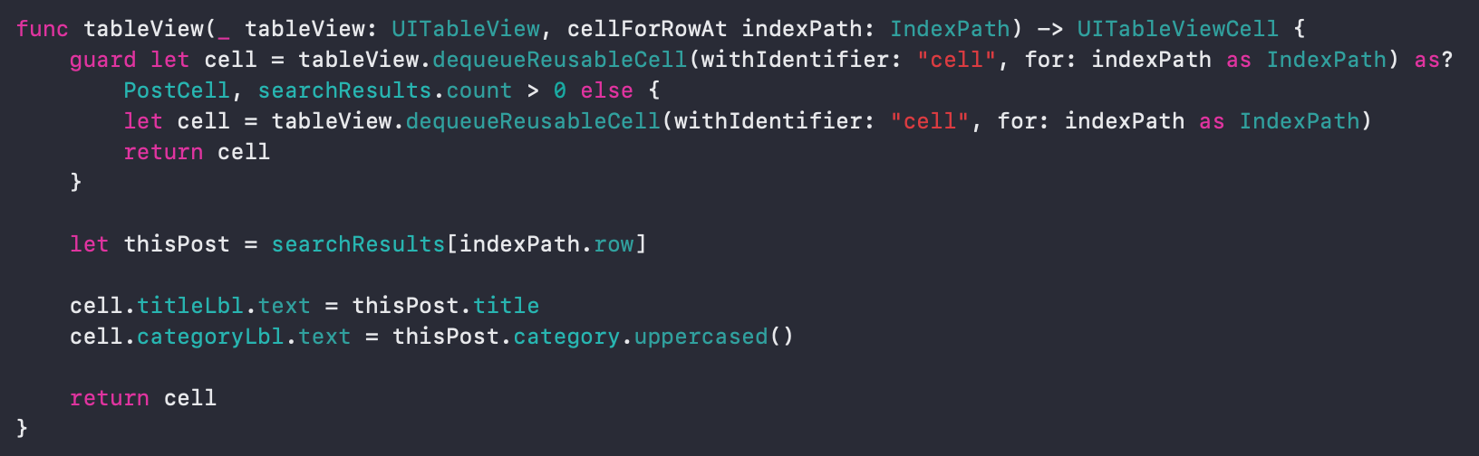
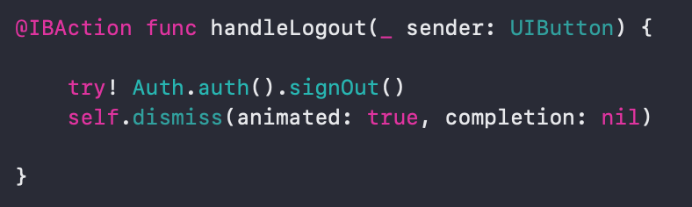
Reddit Lite
Joseph Pereniguez 18129119

Slide 9
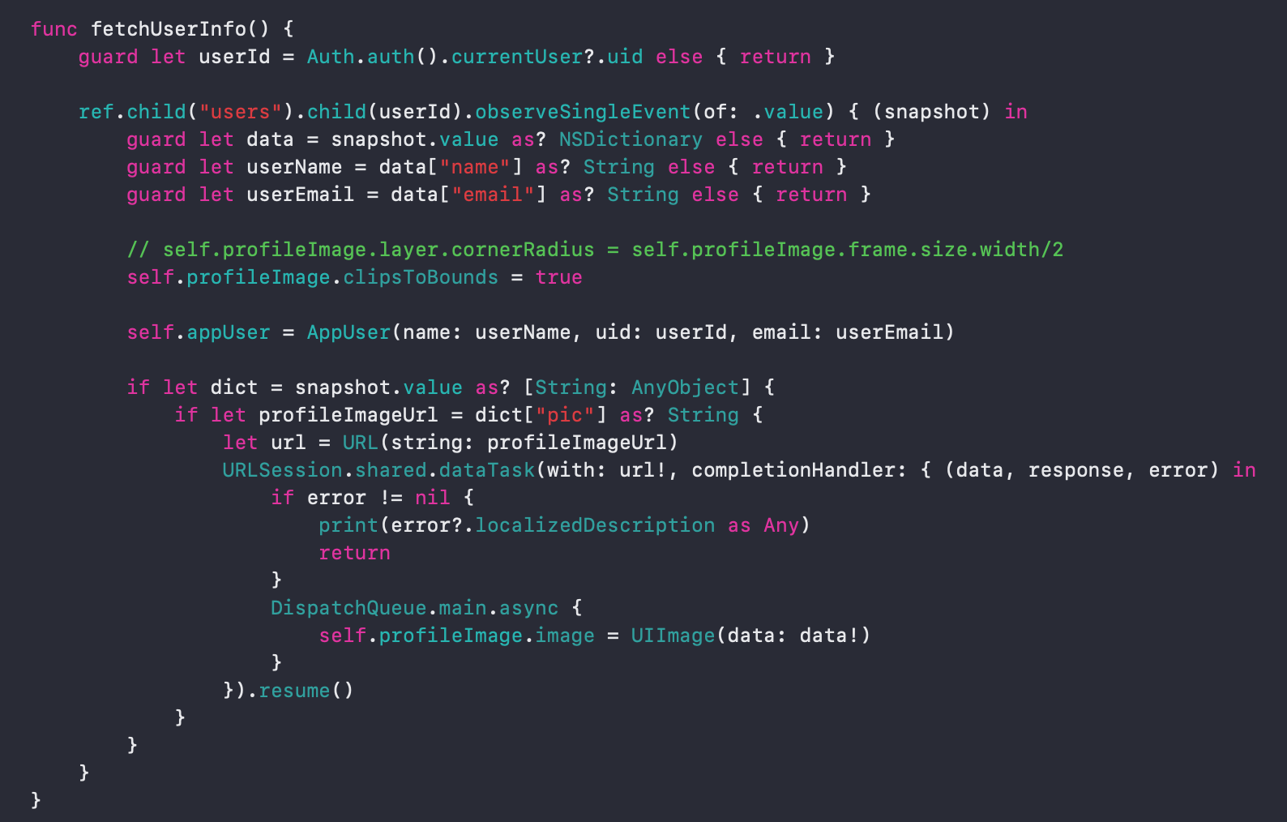
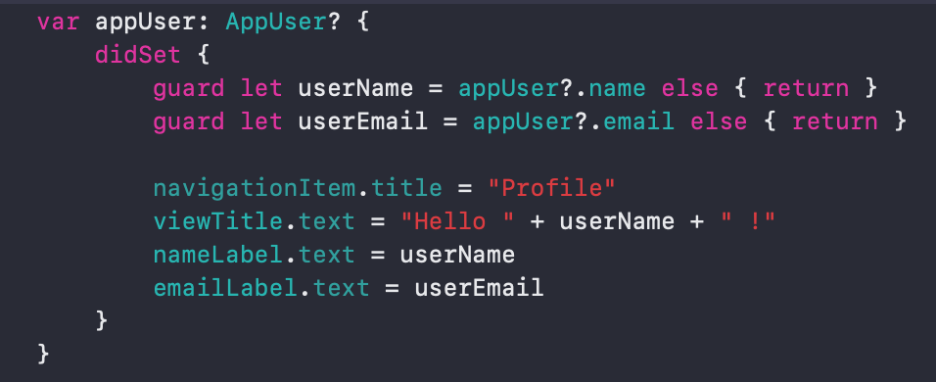
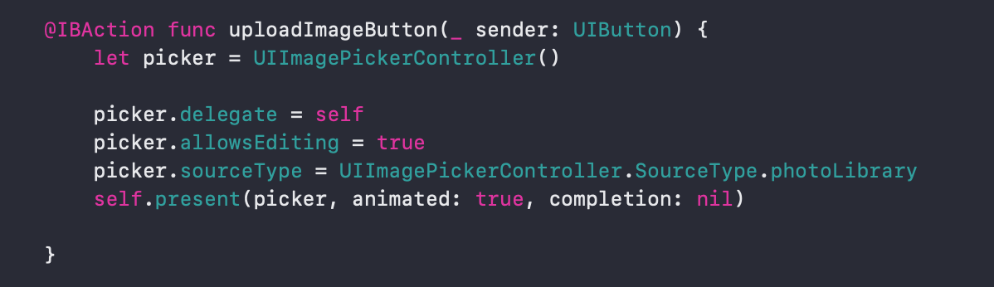
Reddit Lite
Alexandre Thauvin 18129014 / Joseph Pereniguez 18129119

Slide 10
Reddit Lite
THANKS
Our project : https://github.com/alexandre-thauvin/reddit_pulling

